Slide 1
IBM University Engagement Project Submission
LearnMate
An Agentic AI Coach for Personalized Course Pathways, built on IBM Granite via watsonx.ai

Slide 2

Project Title: LearnMate — Agentic AI for Personalized Course Pathways
Domain of Project: Education / EdTech
Student Name | Recent Passport Photo | Email ID | Mobile Number
Theertha P Nair |  | theerthapnair15@gmail.com | 7032354794
LearnMate · IBM Granite on watsonx.ai
2

Slide 3

Problem Statement
Problem Statement No. 12 — Agentic AI for Personalized Course Pathways
The Challenge
Students often struggle to identify the right learning path that aligns with their interests and long-term goals, due to the overwhelming number of online courses and a lack of personalized guidance. Generic course catalogs don't adapt to a learner's actual skill level, stated goals, or progress over time.
The Objective
Act as an Agentic AI coach that interacts with the student directly
Understand stated interests (Frontend Development, Cybersecurity, UI/UX Design, Backend Development)
Assess the student's current skill level through direct interaction
Dynamically build a personalized course roadmap
Adapt the roadmap over time based on progress and stated preferences
LearnMate · IBM Granite on watsonx.ai
3

Slide 4

Proposed Solution
LearnMate is an agentic AI coaching system, built on IBM watsonx.ai and IBM Granite, that turns a static course catalog into an adaptive, personalized pathway.
1
2
3
4
Interact & Assess
Retrieve (RAG)
Reason (Granite)
Adapt & Replan
The student picks an interest track and completes a short self-assessment. LearnMate scores this into a skill level and captures a stated goal in plain language.
A retrieval layer looks up the student's track in a structured course knowledge base, filtering by prerequisites already completed — grounding the agent's reasoning in real course data.
IBM Granite, called via watsonx.ai's chat endpoint, generates a personalized explanation grounded in the retrieved courses, the assessed level, and the stated goal.
As the student marks courses complete or restates their goal, the agent re-runs its perceive-decide-act loop — the roadmap itself changes, not just its wording.
LearnMate · IBM Granite on watsonx.ai
4

Slide 5


Technology Used
IBM Granite (granite-4-h-small)
IBM watsonx.ai
IBM Cloud Lite (WML Runtime)
Foundation model powering reasoning, personalization, and natural-language guidance generation.
Model deployment platform — the chat completions endpoint used to call Granite from the backend.
The Watson Machine Learning Runtime instance that hosts and serves the Granite model to the project.
Retrieval-Augmented Generation
Node.js + Express
React
A structured knowledge base of courses and prerequisites, filtered and retrieved before every Granite call — grounding responses in real data.
Backend REST API: agent logic, retrieval layer, and the watsonx.ai integration.
Frontend dashboard — skill assessment flow, live roadmap display, and progress tracking.
LearnMate · IBM Granite on watsonx.ai
5

Slide 6

System Components Used
01
Skill Assessment UI — React component presenting a short, scored quiz that classifies the student into beginner / intermediate / advanced before any recommendation is generated.
02
Retriever Module — retriever.js — looks up the selected track in the course knowledge base and filters courses by prerequisite completion (the RAG retrieval step).
03
Agent Loop — agent.js — the perceive-decide-act cycle: reads student state, applies assessed level and stated-preference reordering, then calls Granite for grounded reasoning.
04
Preference Engine — Detects urgency vs. depth signals in the student's stated goal and reorders — and resizes — the recommended course set accordingly.
05
watsonx.ai Chat Client — watsonx.js — authenticates via IBM IAM, calls the Granite chat completions endpoint with the retrieved courses and student context.
06
Roadmap Dashboard — React UI rendering the live recommendation set, assessed level, guidance text, and progress — with “Mark complete” triggering a live replan.
LearnMate · IBM Granite on watsonx.ai
6

Slide 7

Agent Workflow
Student selects
interest track
Skill assessment
(quiz → level)
Stated goal
(preference)
Retriever
(RAG lookup)
Preference
reordering
IBM Granite
(watsonx.ai)
Personalized
roadmap
Student marks a course complete → agent re-runs the loop and replans the roadmap
The agent holds state across turns — assessed level, completed courses, and stated goal — rather than answering each request from scratch. This loop is what makes LearnMate an agent, not a one-shot chatbot.
LearnMate · IBM Granite on watsonx.ai
7

Slide 8

Architecture Blueprint
Frontend
Backend
IBM Cloud
React · deployed on Vercel
Node.js + Express · deployed on Render
IBM Cloud Lite
Skill assessment UI
Track selector
Roadmap dashboard
Progress tracking
REST API layer
Retriever (RAG)
Agent loop
Preference engine
watsonx.ai chat endpoint
IBM Granite (granite-4-h-small)
Watson Machine Learning Runtime
IAM authentication
LearnMate · IBM Granite on watsonx.ai
8

Slide 9
Role of Agentic AI in the Solution
Agentic AI is what separates LearnMate from a static recommendation list or a single-turn chatbot. It gives the system memory, judgment, and the ability to act differently as circumstances change.
Perceives
Decides
Acts
Adapts
Reads the student's current state each time it runs and assess level, completed courses, and stated goal rather than treating every request as brand new.
Retrieves eligible courses via RAG, then reorders and resizes the candidate set based on detected urgency or depth signals in the student's own words.
Calls IBM Granite grounded in the retrieved, reordered courses to produce a personalized explanation and not a generic template response.
Re-runs the entire loop whenever the student marks progress or restates their goal, producing a genuinely different roadmap, not just different wording.
LearnMate · IBM Granite on watsonx.ai
9

Slide 10

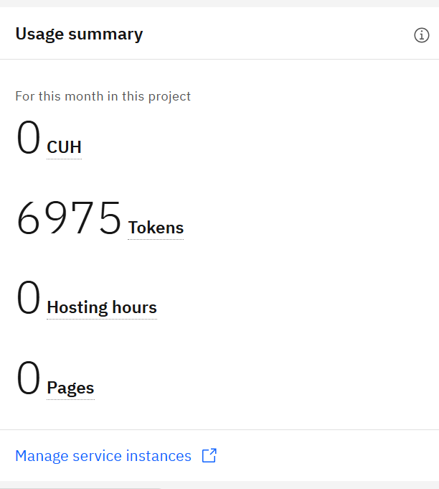
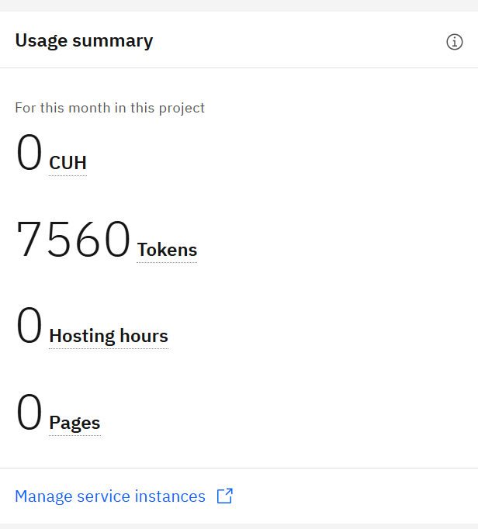
Token Usage
Before Prompt → After Prompt
LearnMate · IBM Granite on watsonx.ai
10

Slide 11

Novelty and Uniqueness
Most course-recommendation tools stop at retrieval. LearnMate closes the loop — what it recommends genuinely changes based on who you are and what you say you need.
Real Skill Assessment A scored quiz actually changes the starting point of the roadmap — it doesn't just decorate a fixed answer.
Preference-Driven Reordering Stating “placement in 3 months” vs. “I want to master this” produces a different set and count of recommended courses — verified, not assumed.
Grounded, Not Generic Every explanation from Granite is grounded in retrieved, prerequisite-filtered course data — RAG before generation, every time.
Genuine Replanning Marking a course complete re-runs the full agent loop, not a cached response — real state, real adaptation.
Fully Deployed Live on the public internet (Vercel + Render), backed by a working IBM Cloud Lite + Granite integration — not a local-only demo.
Built From Scratch Custom Node.js/Express agent and React dashboard — no low-code orchestration layer standing in for the reasoning.
LearnMate · IBM Granite on watsonx.ai
11

Slide 12

GitHub Repository
Backend (agent, RAG retrieval, watsonx.ai integration)
github.com/Theertha1507/learnmate-backend
Frontend (React dashboard, skill assessment UI)
github.com/Theertha1507/learnmate-frontend
Before submitting, confirm each repo includes:
README with setup instructions
This project presentation (.pptx)
Problem statement PDF
Working, tested GitHub URL (public, README enabled)
LearnMate · IBM Granite on watsonx.ai
12

Slide 13
Future Scope
1. Embedding-Based RAG
2. Live Course Platform Integration
Move from structured-JSON filtering to a real vector store, so free-text goals can match against a much larger, less rigidly-tagged course catalog — enabling richer, more flexible retrieval as the knowledge base grows.
Connect to real providers (Coursera, freeCodeCamp, YouTube APIs) so recommendations reflect live availability, ratings, and freshness rather than a hand-curated static list.
3. Voice & Multilingual Interaction
4. Institutional / LMS Integration
Extend the assessment and guidance flow to support voice input and regional languages, widening access for students less comfortable in English-only text interfaces.
Package LearnMate as a plug-in for college LMS platforms, so faculty can track cohort-wide skill progression alongside individual adaptive pathways.
LearnMate · IBM Granite on watsonx.ai
13

Slide 14
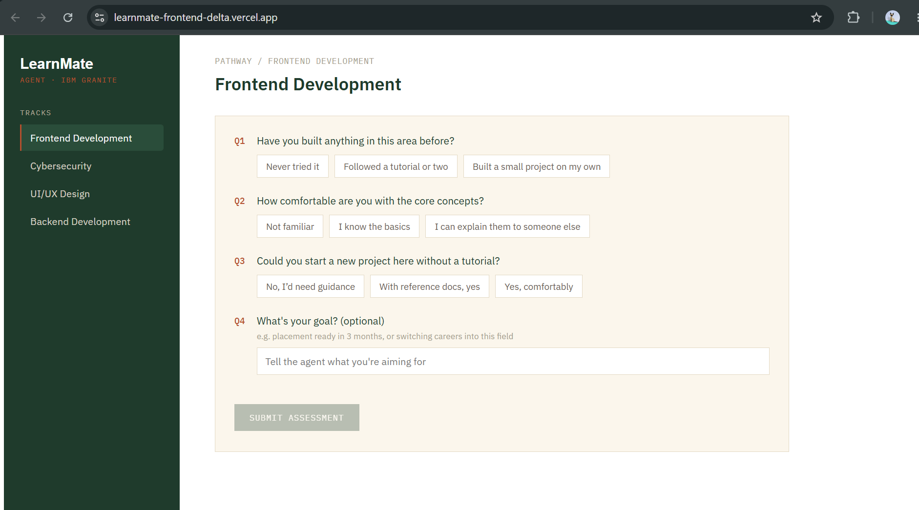

Slide 15
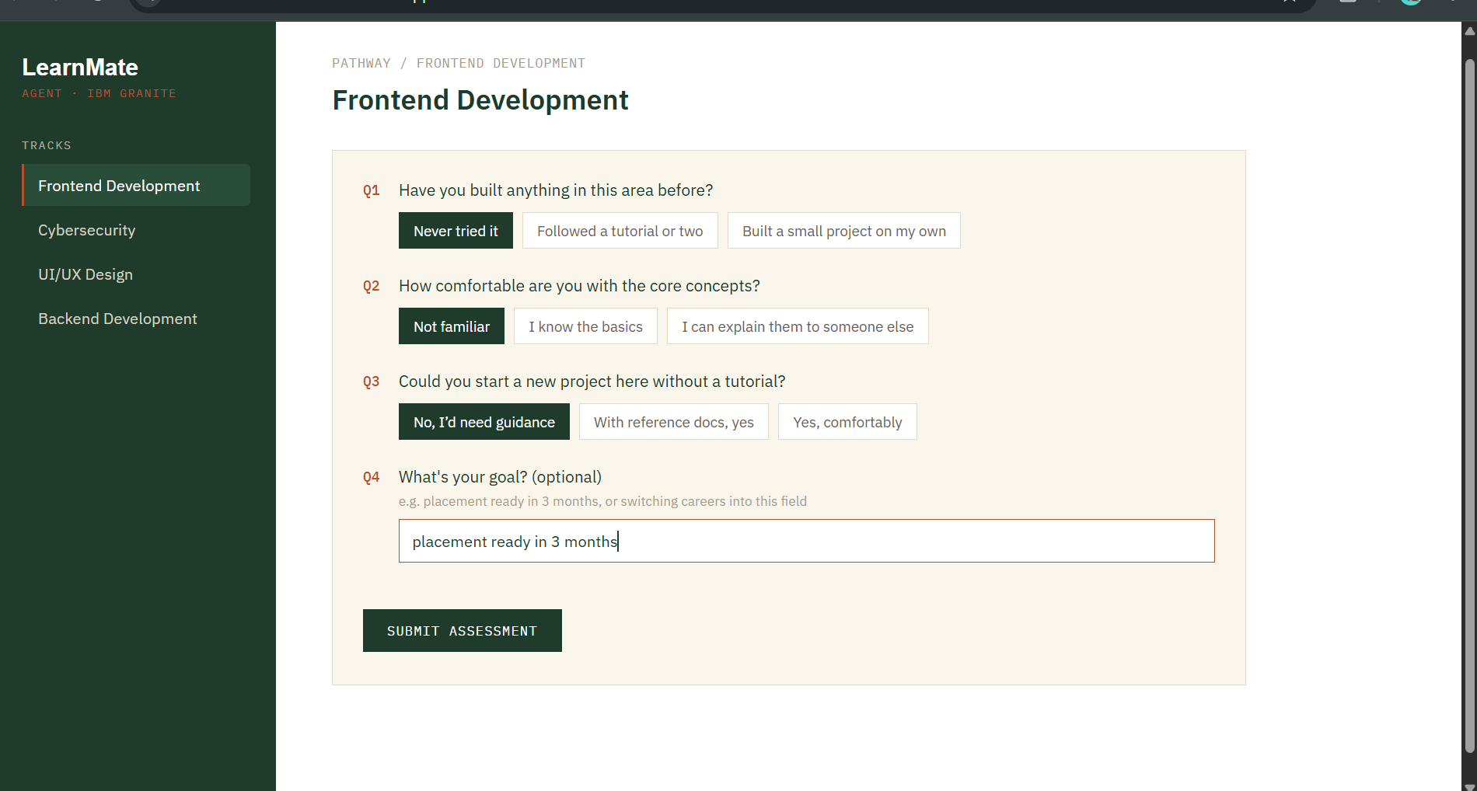

Slide 16
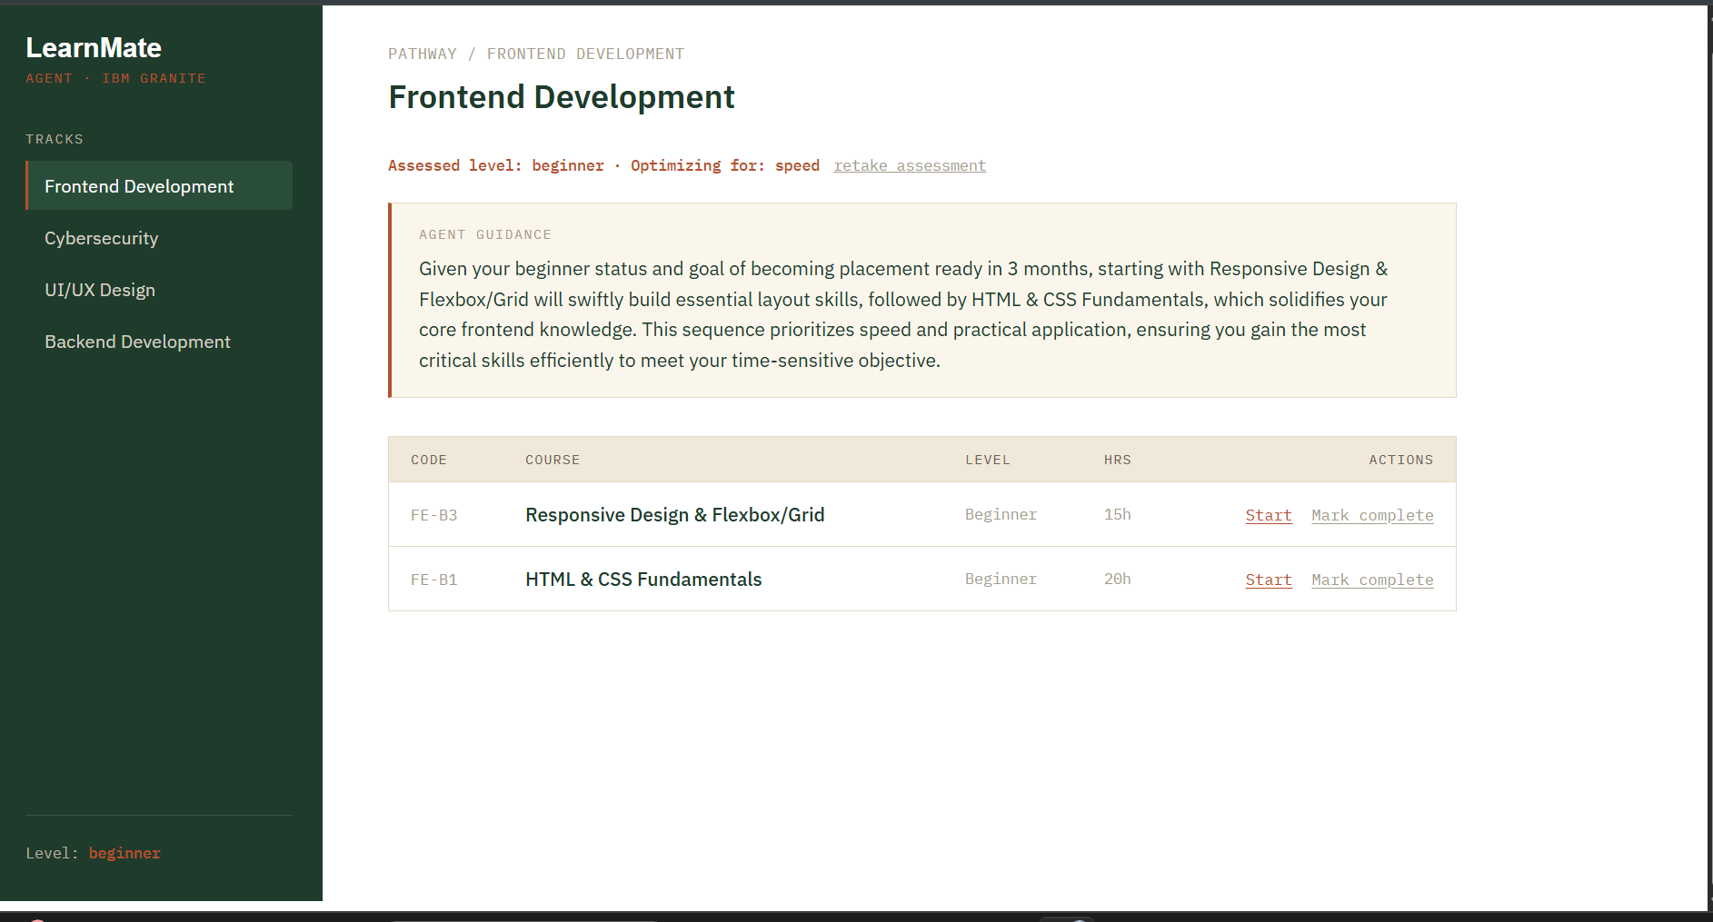

Slide 17
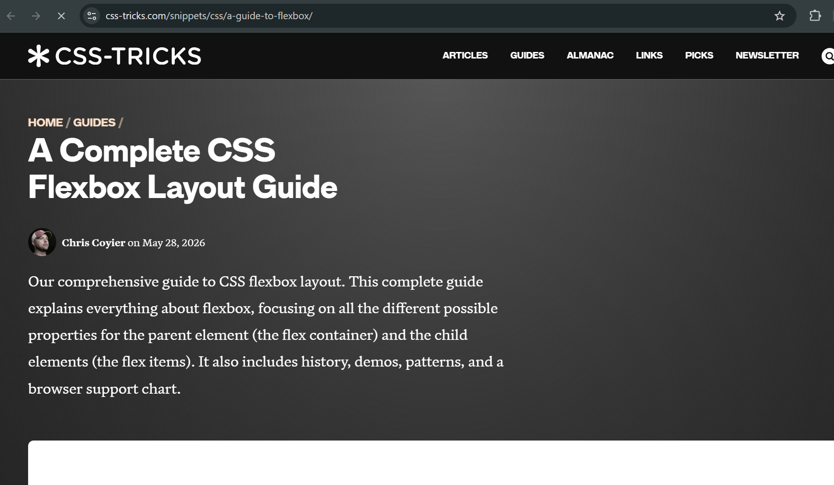

Slide 18
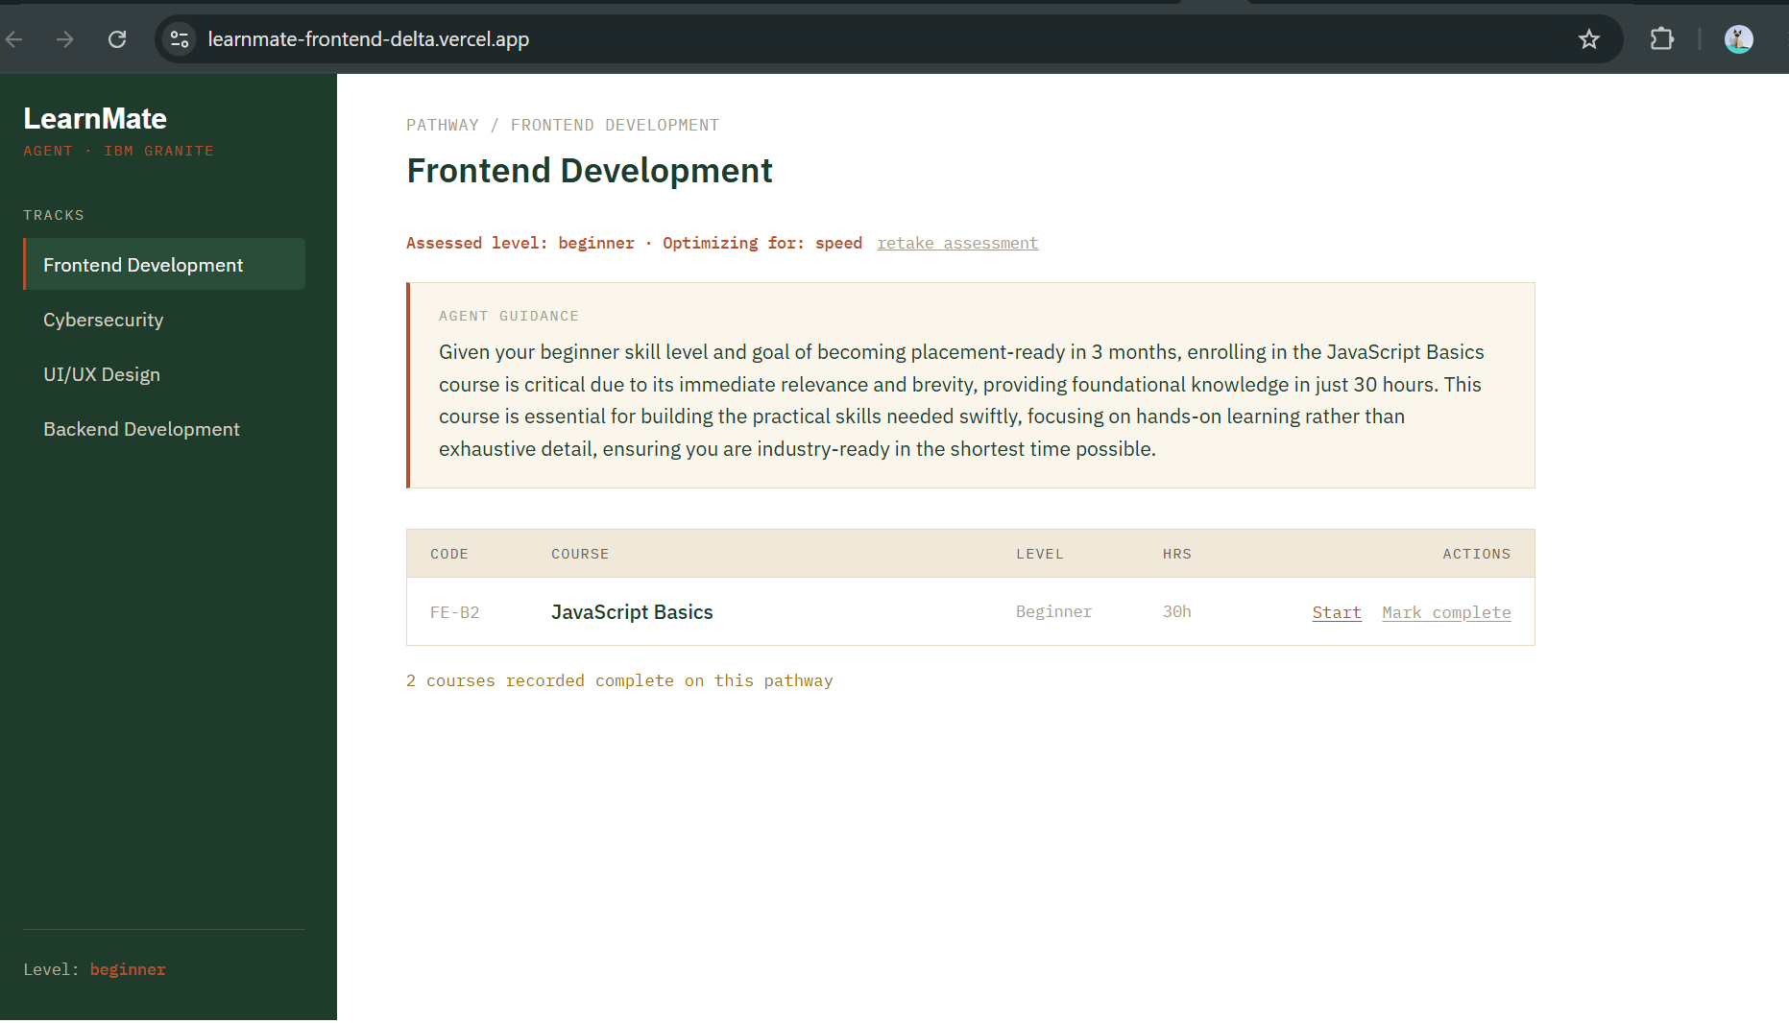

Slide 19


Certificates Earned
LearnMate · IBM Granite on watsonx.ai
14

Slide 20
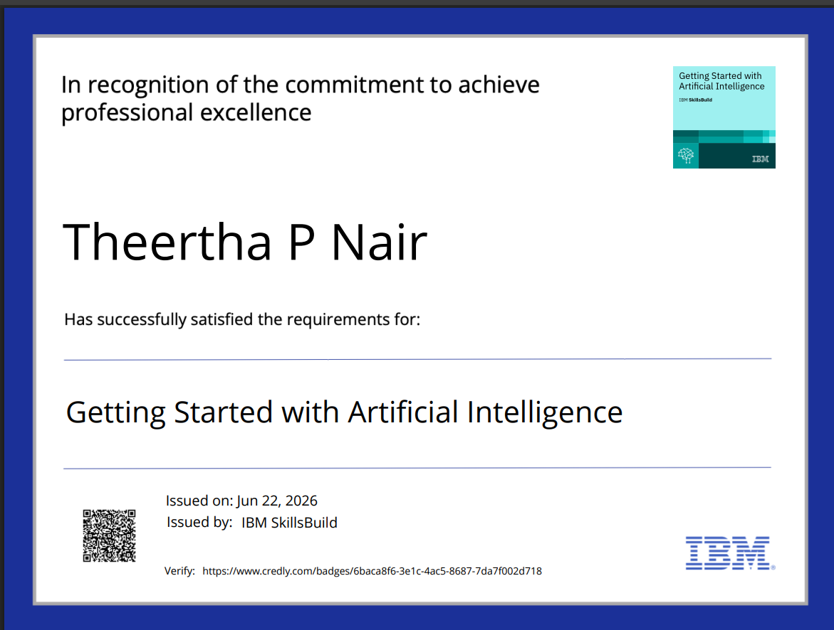
Certificates Earned
[Insert your Credly certificate image here]
LearnMate · IBM Granite on watsonx.ai
14

Slide 21
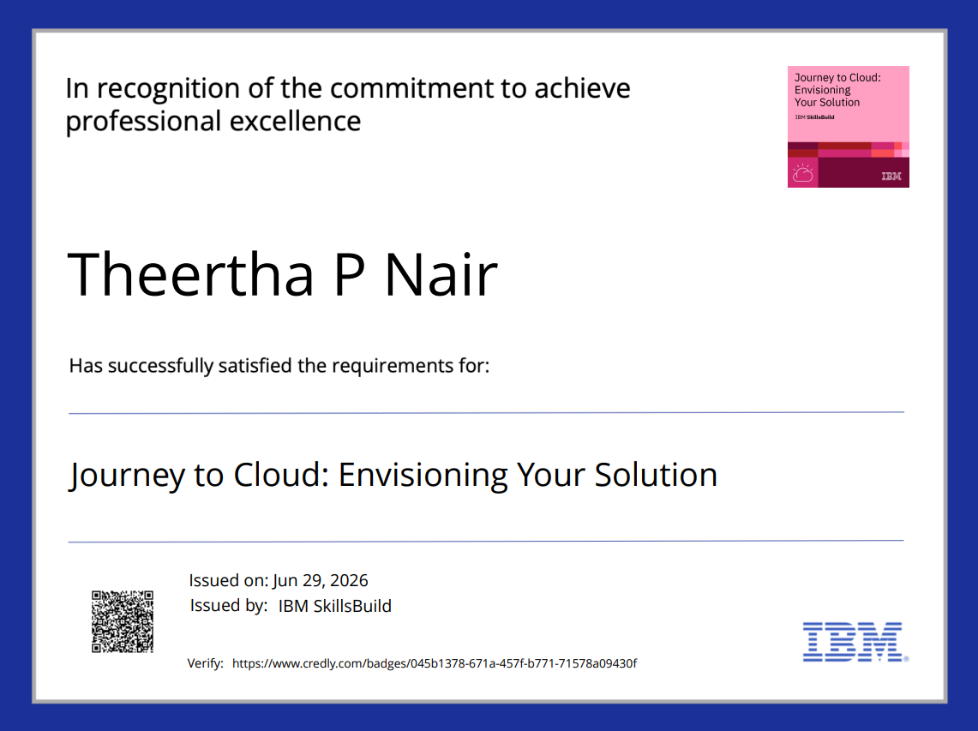
Certificates Earned
LearnMate · IBM Granite on watsonx.ai
14

Slide 22
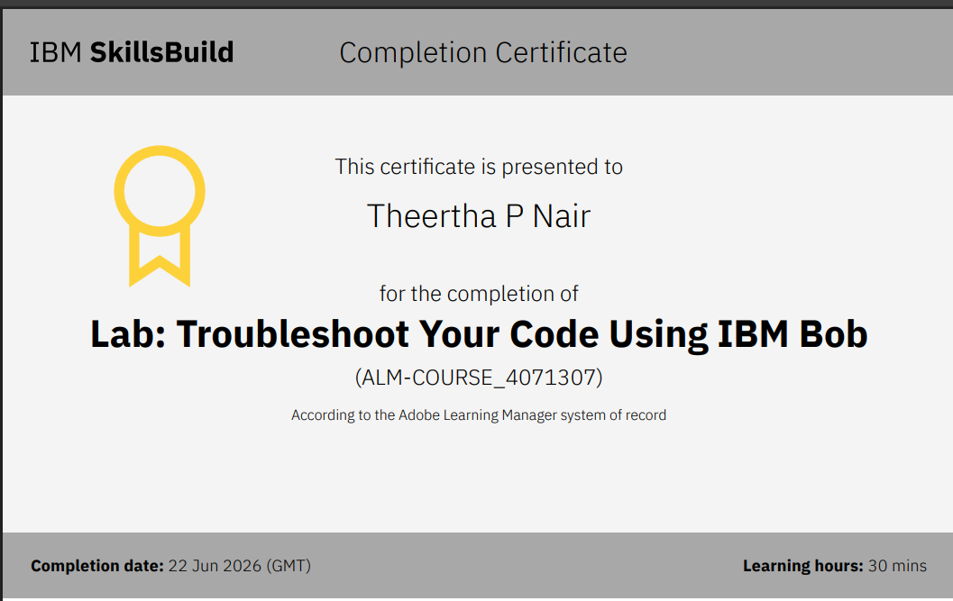
Certificates Earned
IBM BOB Certificate
[Insert your IBM BOB certificate image here]
LearnMate · IBM Granite on watsonx.ai
15

Slide 23
Thank You
LearnMate — built on IBM Cloud Lite and IBM Granite via watsonx.ai
https://github.com/Theertha1507/LearnMate

